Slide 1
Data Structures and Algorithms (BCSE202L)
Module 2: List
Dr. Priyanka N

Slide 2
Types of Lists: Doubly Linked List
Doubly linked list
Pointers exist between adjacent nodes in both directions.
The list can be traversed either forward or backward.
Usually two pointers are maintained to keep track of the list, head and tail.
head
tail
A
B
C

Slide 3
Defining a Node of a Doubly Linked List
Each node of doubly linked list (DLL) consists of three fields:
Item (or) Data
Pointer of the next node in DLL
Pointer of the previous node in DLL
node
Data
prev
next
How to define a node of a doubly linked list (DLL)?
struct node
{
int data;
struct node *next; // Pointer to next node in DLL
struct node *prev; // Pointer to previous node in DLL
};

Slide 4
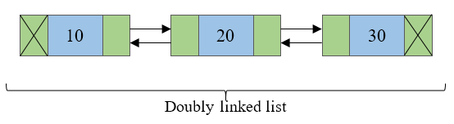
Doubly Linked List
Doubly linked list is a collection of nodes linked together in a sequential way.
Doubly linked list is almost similar to singly linked list except it contains two address or reference fields, where one of the address field contains reference of the next node and other contains reference of the previous node.
First and last node of a linked list contains a terminator generally a NULL value, that determines the start and end of the list.
Doubly linked list is sometimes also referred as bi-directional linked list since it allows traversal of nodes in both direction.
Since doubly linked list allows the traversal of nodes in both direction, we can keep track of both first and last nodes.

Slide 5
Double versus Single Linked List
Advantages over singly linked list
A DLL can be traversed in both forward and backward direction.
The delete operation in DLL is more efficient if pointer to the node to be deleted is given.
Disadvantages over singly linked list
Every node of DLL require extra space for an previous pointer.
All operations require an extra pointer previous to be maintained.

Slide 6
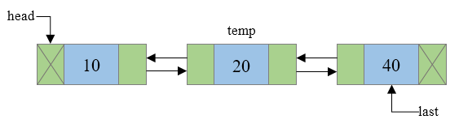
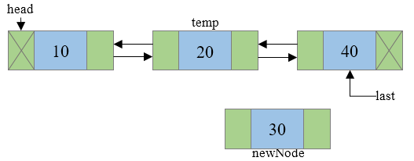
Doubly Linked List: Insertion at any Position
Steps to insert a new node at n^{th} position in a Doubly linked list.
Step 1: Traverse to N-1 node in the list, where N is the position to insert. Say temp now points to N-1th node.
Step 2: Create a newNode that is to be inserted and assign some data to its data field.

Slide 7
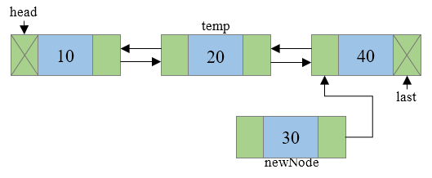
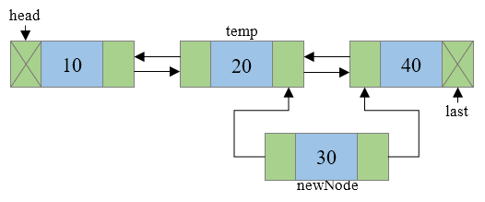
Doubly Linked List: Insertion at any Position
Step 3: Connect the next address field of newNode with the node pointed by next address field of temp node.
Step 4: Connect the previous address field of newNode with the temp node.

Slide 8
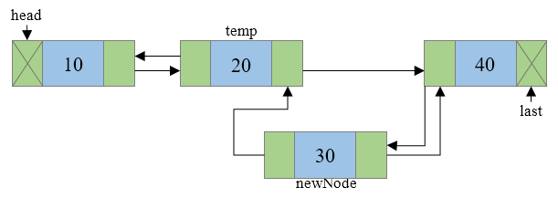
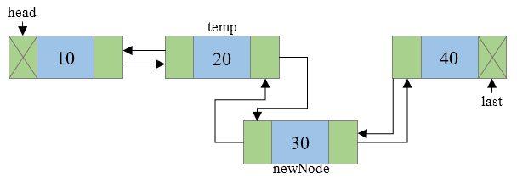
Doubly Linked List: Insertion at any Position
Step 5: Check if temp->next is not NULL then, connect the previous address field of node pointed by temp->next to newNode.
Step 6: Connect the next address field of temp node to newNode.

Slide 9
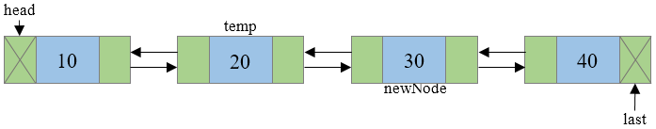
Doubly Linked List: Insertion at any Position
Step 7: Final doubly linked list looks like

Slide 10
Doubly Linked List: Insertion at any Position
#include <stdio.h>
#include <stdlib.h>
struct node { /* Basic structure of Node */
int data;
struct node * prev;
struct node * next;
}*head, *last;
int main()
{
int n, data;
head = NULL;
last = NULL;
printf("Enter the total number of nodes in list: ");
scanf("%d", &n);
createList(n); // function to create double linked list
displayList(); // function to display the list
printf("Enter the position and data to insert new node: ");
scanf("%d %d", &n, &data);
insert_position(data, n); // function to insert node at any position
displayList();
return 0;
}

Slide 11
Doubly Linked List: Insertion at any Position
void createList(int n)
{
int i, data;
struct node *newNode;
if(n >= 1){ /* Creates and links the head node */
head = (struct node *)malloc(sizeof(struct node));
printf("Enter data of 1 node: ");
scanf("%d", &data);
head->data = data;
head->prev = NULL;
head->next = NULL;
last = head;
for(i=2; i<=n; i++){ /* Creates and links rest of the n-1 nodes */
newNode = (struct node *)malloc(sizeof(struct node));
printf("Enter data of %d node: ", i);
scanf("%d", &data);
newNode->data = data;
newNode->prev = last; //Links new node with the previous node
newNode->next = NULL;
last->next = newNode; //Links previous node with the new node
last = newNode; //Makes new node as last/previous node
}
printf("\nDOUBLY LINKED LIST CREATED SUCCESSFULLY\n");
}
}

Slide 12
Doubly Linked List: Insertion at any Position
void insert_position(int data, int position)
{
struct node * newNode, *temp;
if(head == NULL){
printf("Error, List is empty!\n");
}
else{
temp = head;
if(temp!=NULL){
newNode = (struct node *)malloc(sizeof(struct node));
newNode->data = data;
newNode->next = temp->next; //Connects new node with n+1th node
newNode->prev = temp; //Connects new node with n-1th node
if(temp->next != NULL)
{
temp->next->prev = newNode; /* Connects n+1th node with new node */
}
temp->next = newNode; /* Connects n-1th node with new node */
printf("NODE INSERTED SUCCESSFULLY AT %d POSITION\n", position);
}
else{
printf("Error, Invalid position\n");
}
}
}

Slide 13
Doubly Linked List: Insertion at any Position
void displayList()
{
struct node * temp;
int n = 1;
if(head == NULL)
{
printf("List is empty.\n");
}
else
{
temp = head;
printf("DATA IN THE LIST:\n");
while(temp != NULL)
{
printf("DATA of %d node = %d\n", n, temp->data);
n++;
/* Moves the current pointer to next node */
temp = temp->next;
}
}
}

Slide 14
Few Exercises to Try Out
For doubly linked list write a function to:
Insert a node at front of the list and at end of the list.
insert_front(data);
insert_end(data);
delete_front(data);
delete_end(data);
Sort the DLL in ascending order.
Count the number of nodes in the given DLL.

Slide 15
Types of Lists: Circular Linked List
Circular linked list
The pointer from the last element in the list points back to the first element.
head
A
B
C

Slide 16
Circular Linked List
A circular linked list is basically a linear linked list that may be single- or double-linked.
The only difference is that there is no any NULL value terminating the list.
In fact in the list every node points to the next node and last node points to the first node, thus forming a circle. Since it forms a circle with no end to stop it is called as circular linked list.
In circular linked list there can be no starting or ending node, whole node can be traversed from any node.
In order to traverse the circular linked list, only once we need to traverse entire list until the starting node is not traversed again.
A circular linked list can be implemented using both singly linked list and doubly linked list.

Slide 17

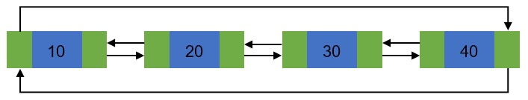
Circular linked list:
Basic structure of singly circular linked list:
Doubly circular linked list:

Slide 18
Circular linked list:
Advantages of a Circular linked list
Entire list can be traversed from any node.
Circular lists are the required data structure when we want a list to be accessed in a circle or loop.
Despite of being singly circular linked list we can easily traverse to its previous node, which is not possible in singly linked list.
Disadvantages of Circular linked list
Circular list are complex as compared to singly linked lists.
Reversing of circular list is complex as compared to singly or doubly lists.
If not traversed carefully, then we could end up in an infinite loop.
Like singly and doubly lists circular linked lists also doesn’t supports direct accessing of elements.

Slide 19
Operations on circular linked list
Creation of list
Traversal of list
Insertion of node
At the beginning of list
At any position in the list
Deletion of node
Deletion of first node
Deletion of node from middle of the list
Deletion of last node
Counting total number of nodes
Reversing of list

Slide 20
Creation and Traversal of a Circular List
#include <stdio.h>
#include <stdlib.h>
/* Basic structure of Node */
struct node {
int data;
struct node * next;
}*head;
int main()
{
int n, data;
head = NULL;
printf("Enter the total number of nodes in list: ");
scanf("%d", &n);
createList(n); // function to create circular linked list
displayList(); // function to display the list
return 0;
}

Slide 21
Circular Linked List: Creation of List
void createList(int n)
{
int i, data;
struct node *prevNode, *newNode;
if(n >= 1){ /* Creates and links the head node */
head = (struct node *)malloc(sizeof(struct node));
printf("Enter data of 1 node: ");
scanf("%d", &data);
head->data = data;
head->next = NULL;
prevNode = head;
for(i=2; i<=n; i++){ /* Creates and links rest of the n-1 nodes */
newNode = (struct node *)malloc(sizeof(struct node));
printf("Enter data of %d node: ", i);
scanf("%d", &data);
newNode->data = data;
newNode->next = NULL;
prevNode->next = newNode; //Links the previous node with newly created node
prevNode = newNode; //Moves the previous node ahead
}
prevNode->next = head; //Links the last node with first node
printf("\nCIRCULAR LINKED LIST CREATED SUCCESSFULLY\n");
}
}

Slide 22
Circular Linked List: Traversal of List
void displayList()
{
struct node *current;
int n = 1;
if(head == NULL)
{
printf("List is empty.\n");
}
else
{
current = head;
printf("DATA IN THE LIST:\n");
do {
printf("Data %d = %d\n", n, current->data);
current = current->next;
n++;
}while(current != head);
}
}

Slide 23
Few Exercises to Try Out
For circular linked list write a function to:
Insert a node at any position of the list and delete from the beginning of the list.
insert_position(data,position);
delete_front();
Reverse the given circular linked link.

